Slide 1
PYTHON INSTALLATION

Slide 2
Kindly perform the installation under parental supervision

Slide 3
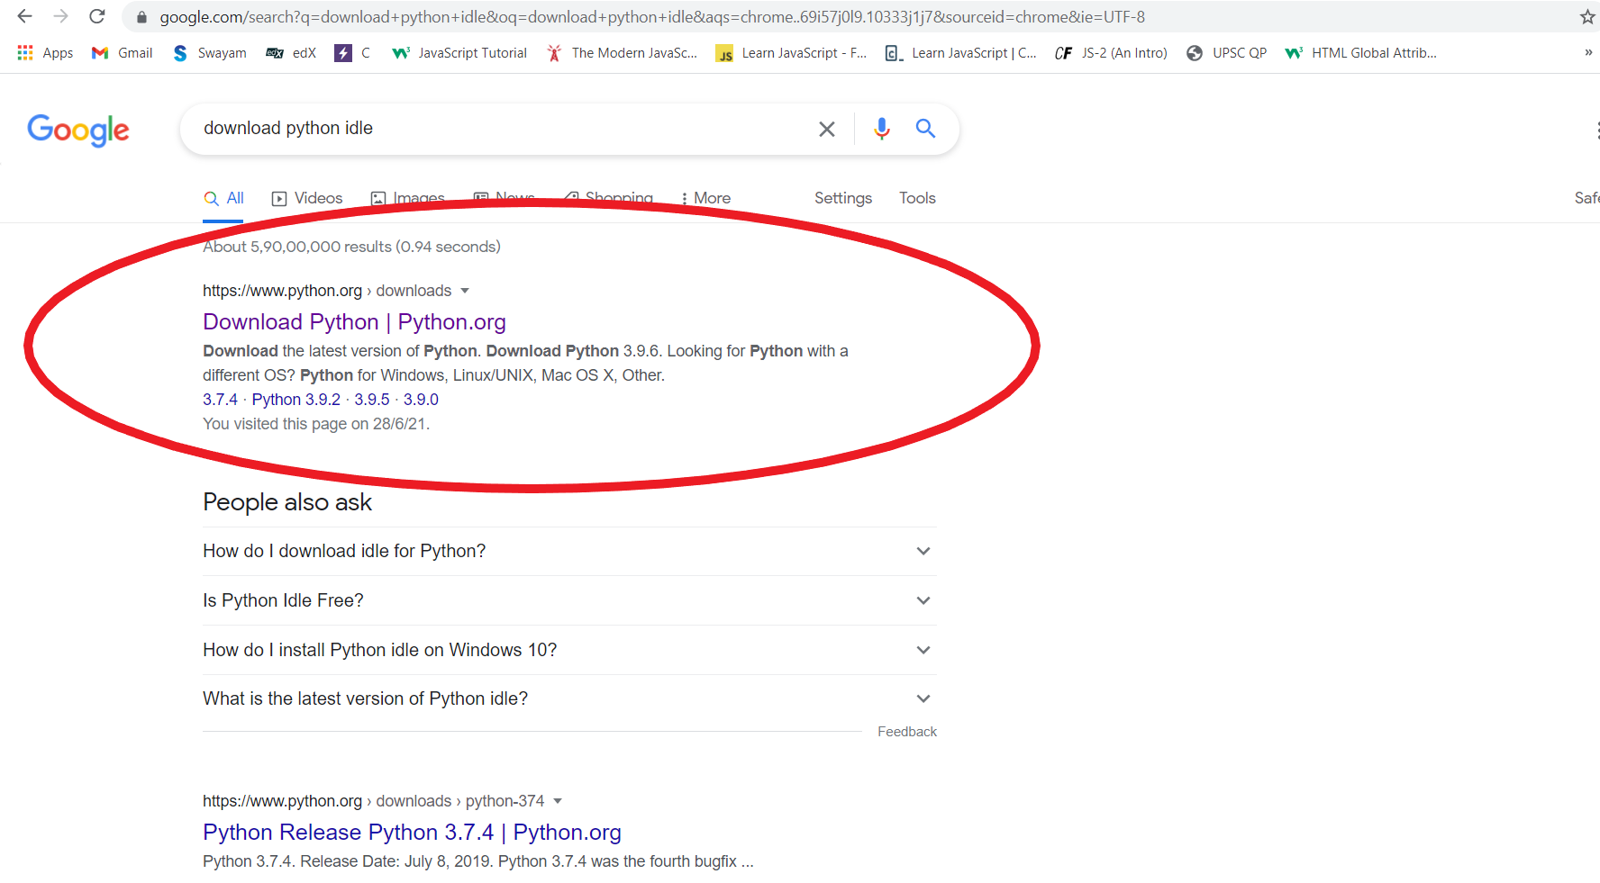
Type “Download Python IDE” in the Search bar and go to www.python.org

Slide 4
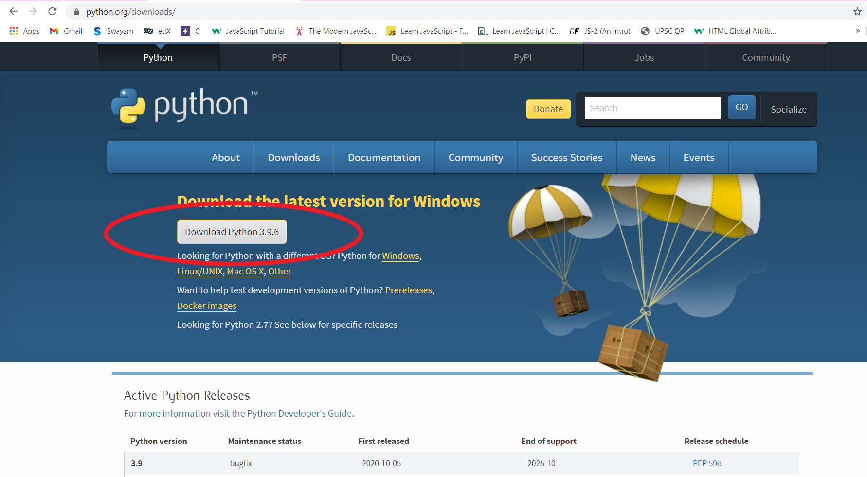
Click on “Download Python 3.9.6” for installation on Windows. Otherwise, click on the OS which you use and install the latest version

Slide 5
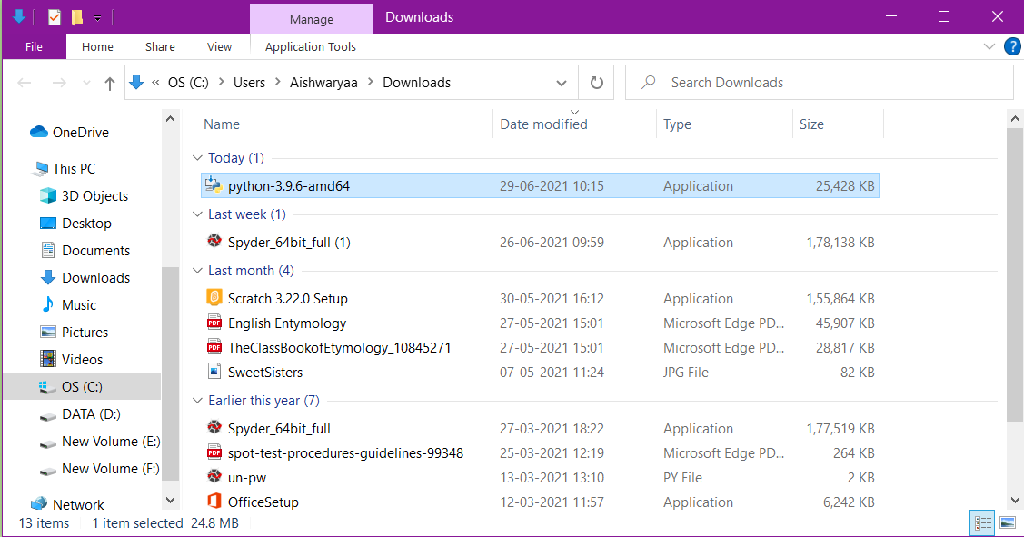
Go to Downloads and click on the installed package

Slide 6
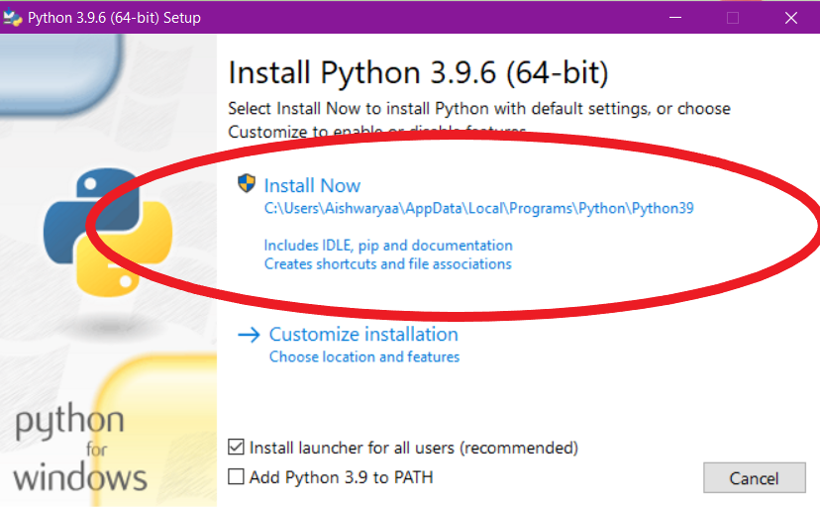
Click on “Install Now”

Slide 7
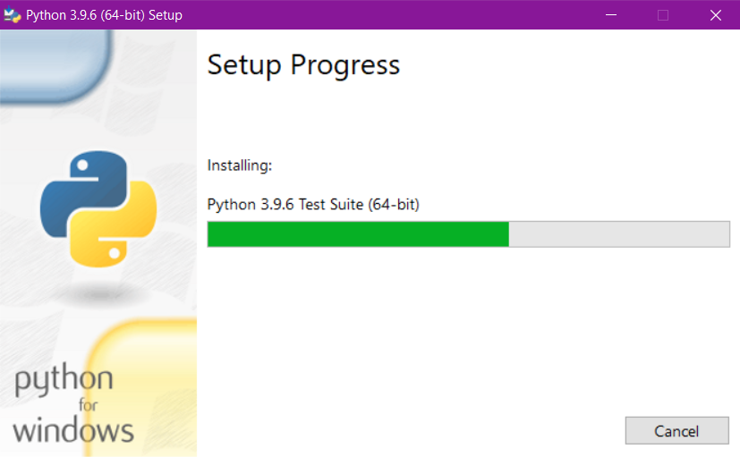

Slide 8
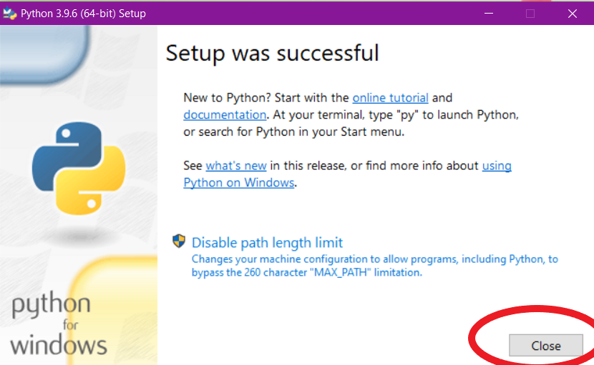
Click on “Close”

Slide 9
You have successfully installed Python

Slide 10
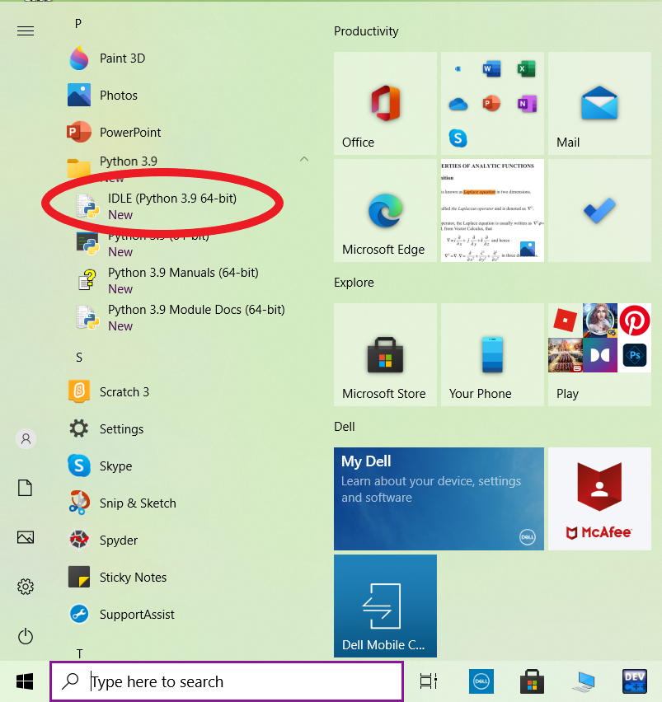
Go to Start and click on “Python 3.9”. In the dropdown menu, click on IDLE (Python 3.9 64-bit).

Slide 11
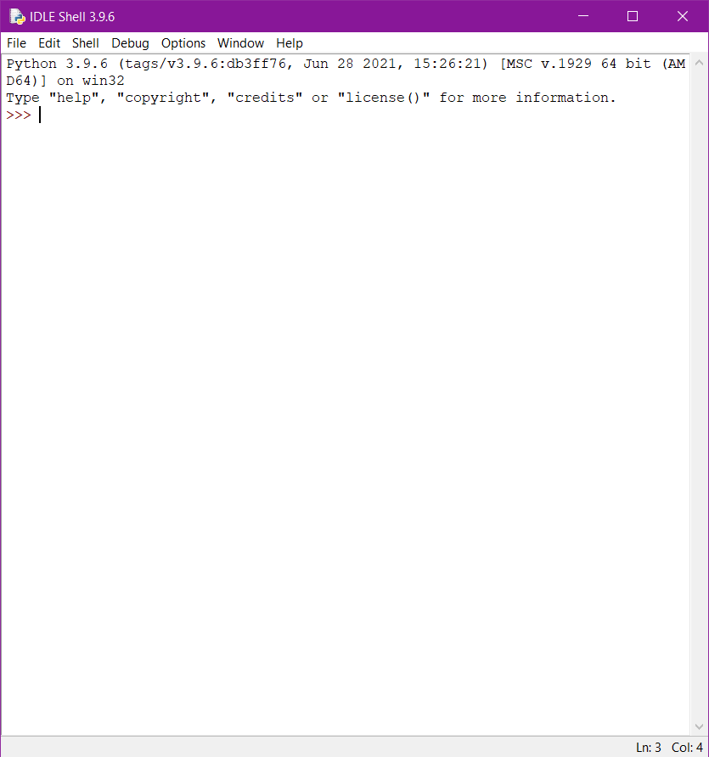
IDLE stands for Integrated Development Learning Environment.

Slide 12
Happy Learning!

